Slide 1
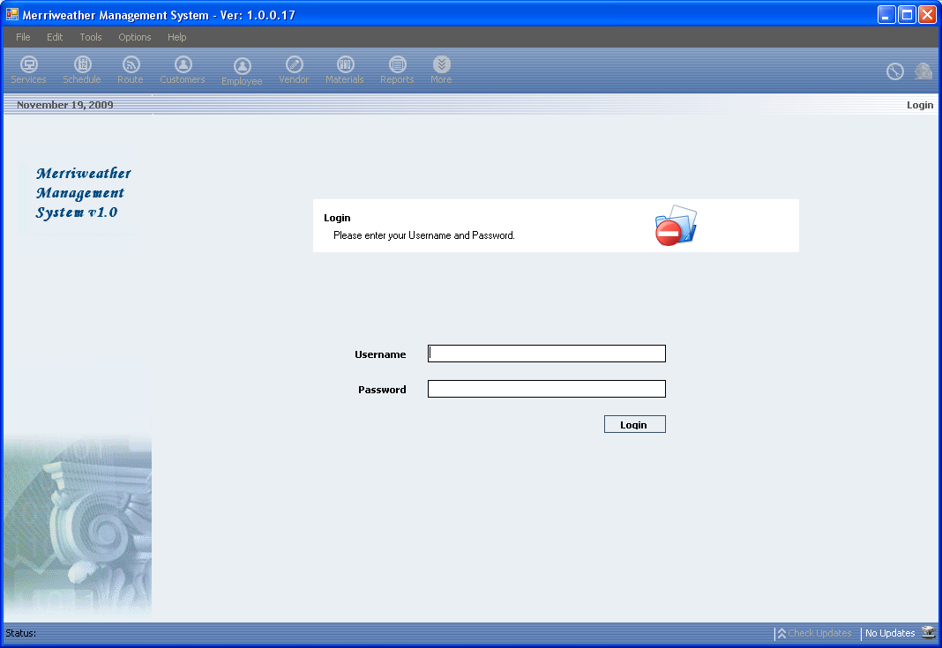
Menu
Title & Version
Toolbar
Security Lock
Today’s Date
View
Check Update
Statusbar

Slide 2
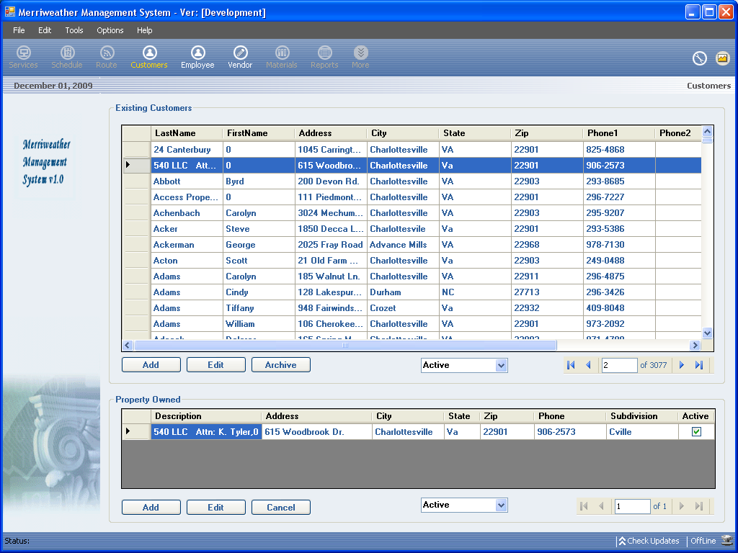
Customer View
Customer Information
Customer Property Information
Editing Buttons
Archive Controls

Slide 3
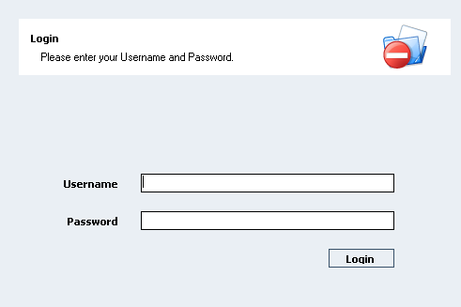
Login View

Slide 4
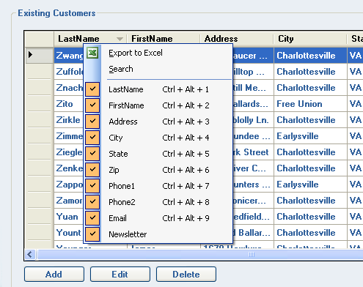
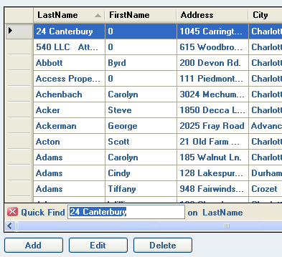
Data Grid.
Selected Column Denoted by a carrot.

Slide 5
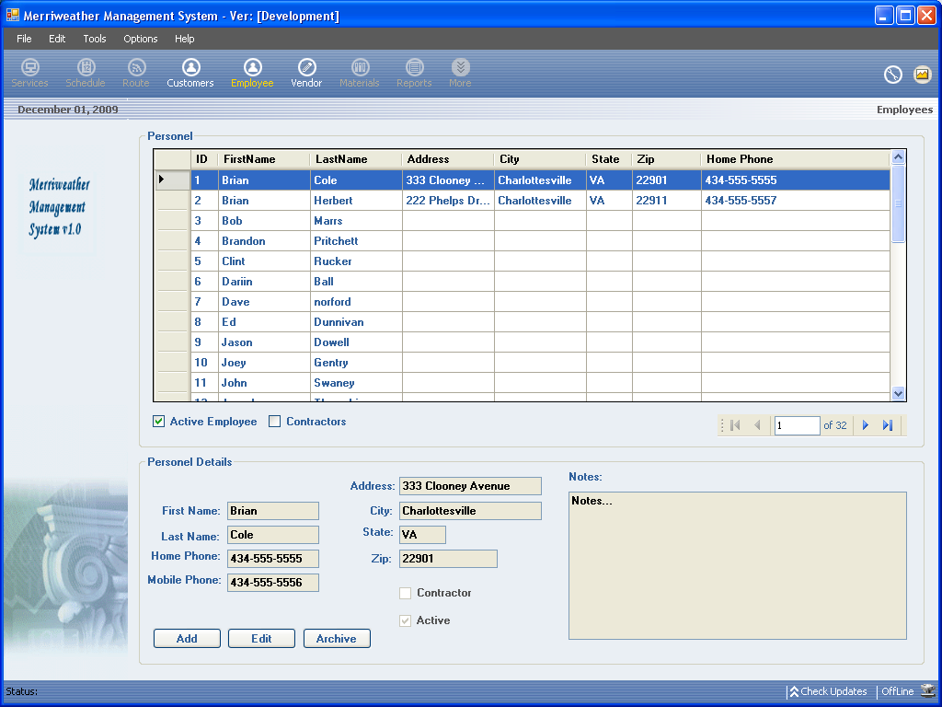
Employee Data Grid
Employee and Contractor Filter
Archive Filter
Archive Checkbox
Employee Detail View

Slide 6
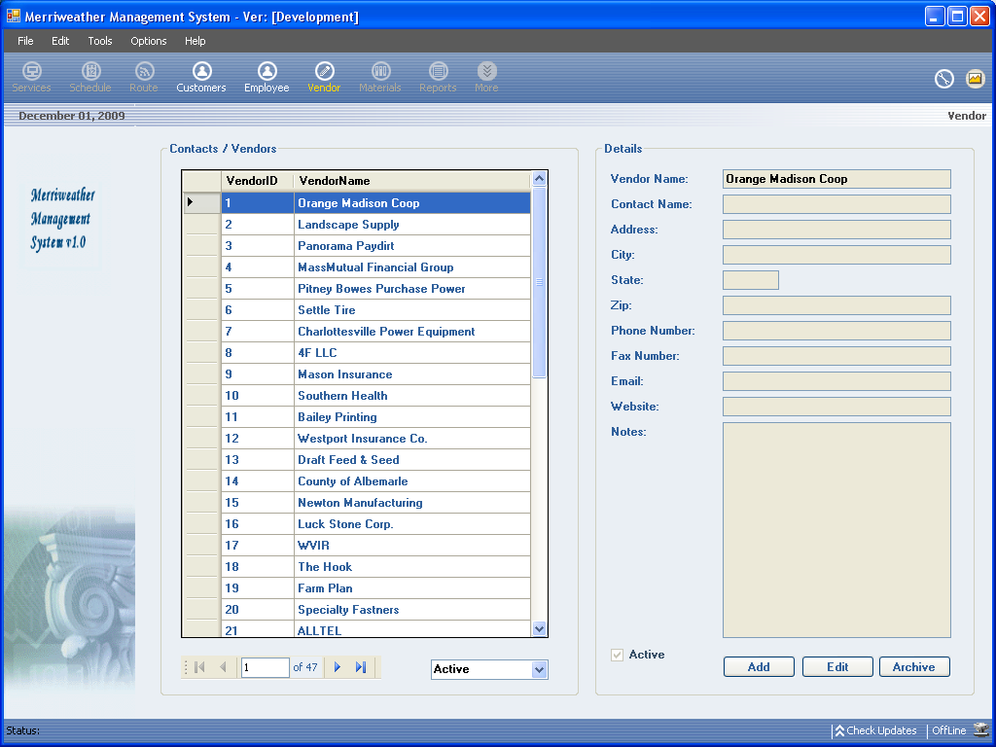
vendor
Vendor List
Archive Filter
Vendor Detail View

